Slide 1

Sanjivani Rural Education Society’s
Sanjivani College of Engineering, Kopargaon-423603
(An Autonomous Institute Affiliated to Savitribai Phule Pune University, Pune)
NAAC ‘A’ Grade Accredited, ISO 9001:2015 Certified
Department of Information Technology
(NBA Accredited)
Seminar Presentation
“Predictive Maintenance of Industrial Equipment’s using IoT and Machine Learning”
Presented By:
Mr. Suyog Balu Dighe(S.Y.B.Tech - 09)
Ms. Arya Subhash Jadhav(S.Y.B.Tech - 19)
Mr. Pramod Sanjay Katare (S.Y.B.Tech - 29)
Ms. Harshada Ravindra Limbhure(S.Y.B.Tech - 39)
Mr. Tushar Sudhakar Patekar(S.Y.B.Tech - 49)
Ms. Bushraa Akbar Humayoon Shaikh(S.Y.B.Tech - 59)
Mr. Ritesh Prashant Gaikwad(S.Y.B.Tech - 69)
Under the guidance of
Dr.N. S. Patankar

Slide 2

Content
Introduction
Literature Survey
Proposed system
Graphs
Limitations of the base system
Conclusion and future scope
References

Slide 3
Introduction
IoT has improved industries, including smart housing, smart grid, smart agriculture, and smart healthcare.
IIoT focuses on monitoring machinery and production processes using sensors.
Predictive Maintenance (PM) in IIoT predicts failures or degradation using sensor data and ML.
ML algorithms are applied to collected data for generating predictions in PM.
IIoT data collection involves streaming data from sensors to the cloud, generating massive amounts of data.
Filtering, compression, and sampling techniques handle the data volume in IIoT.
The cloud is used for data analysis and evaluation in IIoT.
Data reduction techniques minimize the data transferred to the cloud in IIoT.
ML models used in PM may face accuracy trade-offs with smaller datasets.

Slide 4
Literature Survey
Predictive maintenance aims to prevent downtime and reduce costs.
IoT and machine learning revolutionize predictive maintenance.
The literature review explores IoT and machine learning in industrial equipment maintenance.
Topics covered include condition monitoring, machine learning techniques, sensor selection, anomaly detection, and fault diagnosis.
Sensor technologies for real-time data collection and monitoring.
Evaluation of machine learning methods for data analysis and feature extraction.
Fault identification, prognostic models, and anomaly detection discussed.
Decision-support systems and ROI evaluation for maintenance planning.
Challenges in data quality, scalability, cybersecurity, and future research directions.

Slide 5
Proposed System
IoT predictive maintenance utilizes sensors and IoT technologies to gather real-time data on equipment condition and potential problems.
Data collection involves monitoring various factors such as temperature, pressure, and vibration.
The collected data is transmitted to a centralized system or cloud platform for storage and analysis.
Data preparation involves cleaning, normalizing, and transforming data for analysis.
Feature engineering captures equipment behavior and performance characteristics.
Machine learning algorithms are trained using historical data on normal operation and known failures.
Anomaly detection is performed using updated sensor data to identify deviations from normal behavior.
Predictive maintenance enables proactive scheduling of repairs and replacements to prevent breakdowns.

Slide 6
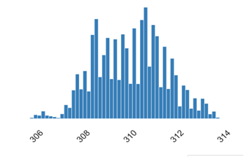
Processing Temperature:
➢ The term "process temperature" refers to the bare minimum temperature of the heating medium that must be maintained in accordance with the process schedule.
➢ PT is represented in the graph above by the real number (R) and the letter (K).
➢ According to the information up above, the product's minimum process temperature is 305.7 K.
➢ The process temperature's highest value is 313.8 K.
➢ Consequently, a product's average mean process temperature is roughly 310.0055 K.
Figure 1: A sample line graph that shows Process temperature [K] and Real Number (R)

Slide 7
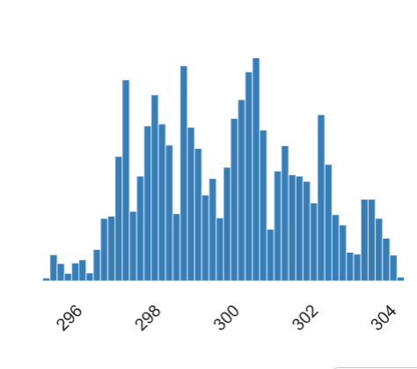
Air Temprature:
➢ When the climate changes due to hot or cold weather, the term "air temperature" is used.
➢ The product's minimum air temperature is 295.3 K, as can be seen from the graph above.
➢ Additionally, 304.5 K is the highest possible value for air temperature.
➢ The product has a 300.0049 K. average mean air temperature.
Figure 2: A sample line graph that shows Air temperature [K] and Real Number (R)

Slide 8
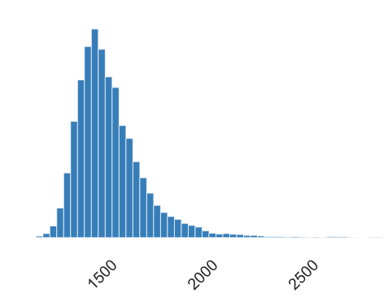
Speed of Rotation:
➢ Information about rotational speed is displayed in the above graph.
➢ A rotating system's rotational speed, also known as speed or speed of rotation, can be calculated as the number of rotations it completes in a predetermined amount of time.
➢ Rotational speed is measured in rpm.
➢ The product in the graph above has a minimum rotational speed of 1168 rpm.
➢ Additionally, 1168 rpm is the maximum rotating speed.
➢ In the graph above, the average mean rotational speed is 1538.7761 rpm.
Figure 3: A sample line graph that shows Rotational Speed [rpm] and Real Number[R]

Slide 9
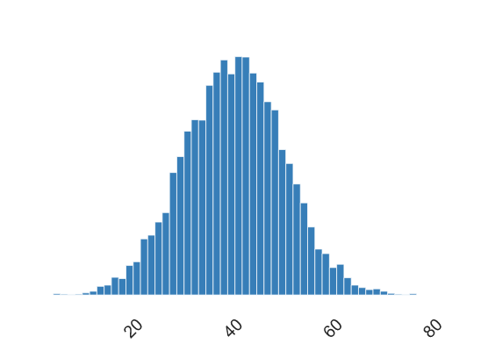
Torque:
➢ Data on torque are displayed in the above graph.
➢ An axial rotational force that twists or turns is known as a torque.
➢ The SI unit for torque is Nm.
➢ According to the above graph, the minimum torque is 3.8 Nm.
➢ And 76.6 Nm. is the maximum value of torque.
➢ The mean torque value is 39.98691 Nm on average.
Figure 4: A sample line graph that shows Torque [Nm] and Real Number (R)

Slide 10
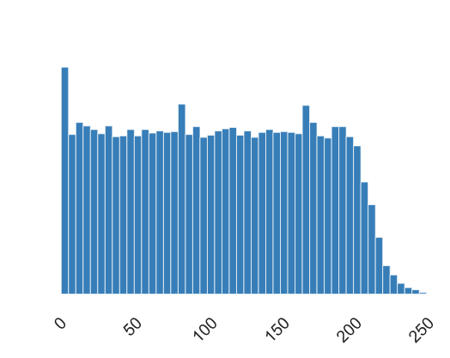
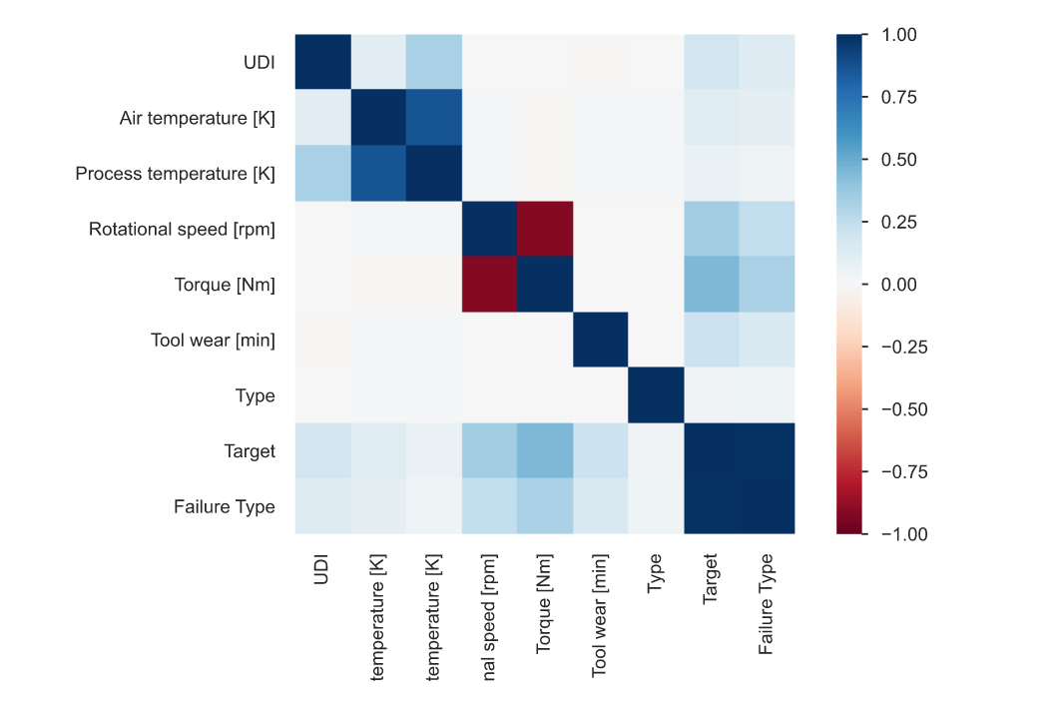
Proposed System
Figure 5: A sample line graph that shows Tool Wear [min] and Real Number (R)
Figure 6: Heat-map [Correlations]

Slide 11
Proposed Work
Increased maintenance efficiency and operational effectiveness through real-time data and predictive analytics.
Cost savings by avoiding unplanned outages and optimizing maintenance plans.
Enhanced equipment reliability and lifespan through early fault identification and resolution.
Improved workplace safety by preventing equipment-related incidents or accidents.
Better inventory management by providing spare parts availability and consumption information.
Data-driven decision-making for process improvement and strategic judgments.
Enhanced customer satisfaction through reduced downtime and increased reliability.
Continuous improvement through feedback loops and learning from past mistakes.
IoT and machine learning-based predictive maintenance can significantly improve maintenance procedures.

Slide 12
Limitations Of Predictive Maintenance Predictive Maintenance
Data availability and quality can impact the system's accuracy.
Limitations of sensing devices may affect the effectiveness of the system.
Complex machine learning models can pose computational challenges.
Scalability may be an issue when handling a large volume of data or equipment.
Limited availability of maintenance expertise can hinder system implementation.
Cost considerations for infrastructure, sensors, and resources.
Iterative process required for continuous improvement.
Sensing limitations affect accuracy.
Model complexity requires computational resources.

Slide 13
Conclusion
The integration of IoT and machine learning in predictive maintenance offers increased efficiency, cost savings, enhanced equipment reliability, improved safety, better inventory management, data-driven decision-making, customer satisfaction, continuous improvement, and the potential for transformative optimization in industrial equipment maintenance processes.

Slide 14
References
IoT-enabled Condition Monitoring:
a. Gao, R., et al. (2018). "A Review on Data-Driven Approaches for Industrial Process Monitoring and Fault Diagnosis." IEEE Transactions on Industrial Electronics. This study provides an overview of data-driven approaches for monitoring industrial processes and fault diagnosis, highlighting the integration of IoT sensors and data analytics techniques.
b. Zhou, K., et al. (2019). "An IoT-Based Approach for Real-Time Monitoring and Predictive Maintenance of Equipment in Smart Factories." Sensors. The authors propose an IoT-based framework for equipment monitoring and maintenance in smart factories, utilizing sensor data fusion, machine learning algorithms, and cloud computing.

Slide 15
References
Machine Learning Techniques for Predictive Maintenance:
a. Zhao, Y., et al. (2019). "A Comprehensive Survey on Industrial Machine Learning for Predictive Maintenance Applications." IEEE Transactions on Systems, Man, and Cybernetics: Systems. This survey paper provides an extensive overview of machine learning techniques, such as support vector machines, random forests, and deep learning, applied to predictive maintenance in industrial settings.
b. Wang, Z., et al. (2020). "A Comparative Study of Machine Learning Algorithms for Predictive Maintenance." Journal of Manufacturing Systems. The authors compare the performance of various machine learning algorithms, including logistic regression, decision trees, and gradient boosting, for predictive maintenance tasks, considering factors such as accuracy and computational efficiency.

Slide 16
References
Feature Engineering and Sensor Selection:
a. Vachtsevanos, G., et al. (2015). "Machine Learning in Cyber Physical Systems: A Brief Overview." Proceedings of the IEEE. This paper presents an overview of feature engineering techniques for cyber-physical systems, emphasizing the importance of sensor selection, signal preprocessing, and feature extraction for effective predictive maintenance.
b. Jia, Y., et al. (2021). "Feature Selection for Predictive Maintenance: A Review and Perspective." Reliability Engineering & System Safety. The authors review feature selection methods used in predictive maintenance, including statistical techniques, dimensionality reduction, and information gain, with a focus on their applicability to IoT-based systems.

Slide 17
References
Anomaly Detection and Fault Diagnosis:
a. Saxena, A., et al. (2019). "A Review of Anomaly Detection Techniques for Time Series Data." IEEE Transactions on Big Data. This comprehensive review paper explores various anomaly detection techniques applicable to time series data, which are commonly encountered in industrial equipment monitoring. The authors discuss methods such as statistical approaches, clustering, and deep learning-based anomaly detection.
b. Liu, W., et al. (2021). "A Review of Fault Diagnosis Methods for Industrial Equipment Based on Machine Learning." Journal of Manufacturing Systems. This review paper provides an overview of machine learning-based fault diagnosis methods, including unsupervised, supervised, and semi-supervised approaches, highlighting their application in industrial equipment maintenance.
Machine learning for predictive maintenance of industrial machines using IoT sensor data November 2017 DOI:10.1109/ICSESS.2017.8342870 Conference: 2017 8th IEEE International Conference on Software Engineering and Service Science (ICSESS)

Slide 18
Thank you..!

